Slide 1
Quizzes:
available for completion weekly from 8 am on Mondays until 11:59 pm on Thursdays
No makeups after deadline!

Slide 2
Homeworks:
available for completion from
8 am on Thursdays.
It is recommended to have them completed weekly before 11:59 pm on next Wednesdays.
It will remain available for completion after that deadline, until end of semester. However, late submission will be penalized – your grade will be lowered up to certain degree.

Slide 3
Introduction
PHYS 2325

Slide 4
Physics studies the Nature.
Ultimately, it aims to understand how the Universe behaves.

Slide 5
It is our belief that there are rules by which universe functions, that those laws are discoverable, at least partially, by humans.

Slide 6
It is also believed that those laws could be used to predict the future, if complete information about present state is available.

Slide 7
HUMAN SENSES
From the moment we born, we actively acquire biological signals initiated by surrounding. This happens as a result of us having highly advanced network of fine biosensors, which we use to call simply human senses.
Early hunting experiences: associations, memory and thoughts
Present: physics in daily life and special projects

Slide 8
MATTER
Anything we sense associate with "matter" or "material objects"
The sense of matter comes along with the sense of "space" and "time", i.e. the sense that matter is embedded into space and time. Through senses, we identify also a "position" in space and a "moment" in time for material objects.

Slide 9
MOTION
Next step: we observe "motion" (change of position) of objects in space and "evolution" in time.
Also, these two changes look similar, there is an essential difference – in space you can evenly move back and forth. However, time is always running forward.
Time machines still remain as a dream.

Slide 10
THEORIES
"Theories" are sets of statements that are partly or fully confirmed through series of "experiments“, valid in certain range of assumptions.
"Hypotheses" are statements pending to be proved.
Sometimes, if it’s not easy to have certain hypotheses proven. However, in certain cases, hypotheses assumed valid and used as basic statements for the theory without proof. In that case, they are called “axioms”.
"Scientific laws" are statements that reflect the general truth about nature, the rules the nature follows.
"Models" are certain idealizations or simplification of the objects. (Example of model: "particle")

Slide 11
EXPERIMENTS
"Experiments" are special setups which allow to find out dependencies between physical quantities or to test certain assumptions.
Experiments usually include "measurements" as well, when qualitative conclusions supplemented by quantitative results.

Slide 12
Scientific method
hypothesis
experiment
theory

Slide 13
Physics and other disciplines
Historically, physics was a foundation of many disciplines. It tremendously influenced WITH chemistry, astronomy, engineering and other fields:
Chemistry - rooted in atomic and molecular physics
Engineering - de facto is applied physics: structural stability, acoustics, heating, lightning and cooling
Geology - radioactive dating of rocks, earthquake analysis, heat transfer
Hybrids disciplines: biophysics and geophysics
Physics in biological and medical research. In particular, physics can actually deal and explain sensory phenomena: as ear hearing sounds, eye detecting colors.

Slide 14
Chapter 1: Units and Standards
Mathematical and physical quantities
Some quantities are so fundamental that the only way to define them only by describing how to measure - it is called operational definition
Metric, International System(SI) and SGS systems of standards:
https://www.youtube.com/watch?v=WuaxXcgX6Rc

Slide 15
Estimates
Erathosthenes (240 B.C.) – measuring radius of Earth
Syene (Egypt) Alexandreia(Greece)
well location objects cast shadow at the same date and time
Enrico Fermi – calculations “on the back of envelope”
EST CST MST PST
about 1000 miles for each time zone shift

Slide 16
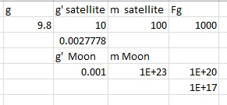

Order of Magnitude Calculations
Scale of gravitational attraction
Average speed of electron in atom

Slide 17
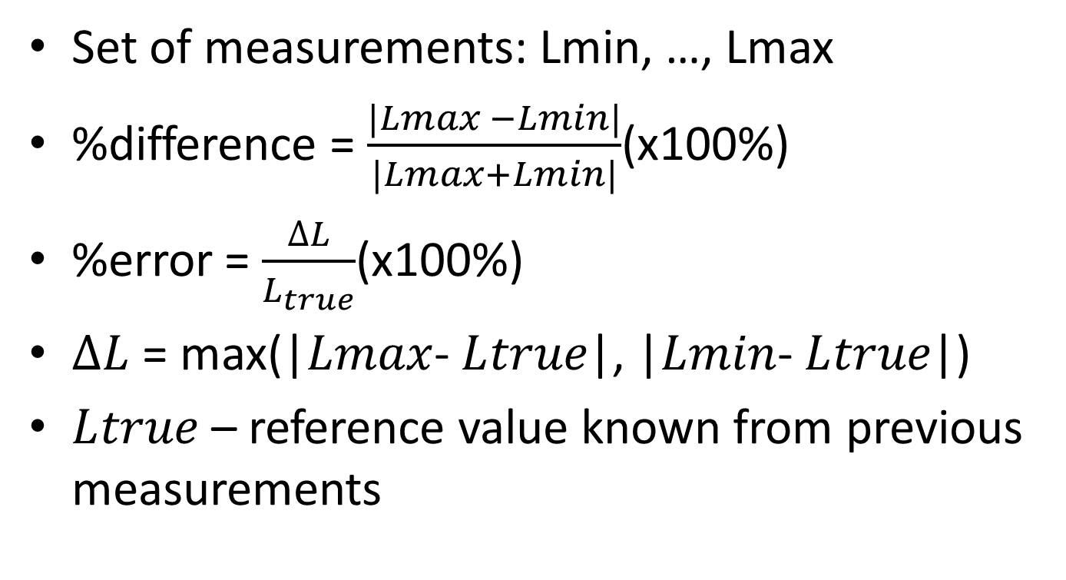
Uncertainty
Set of measurements: Lmin, …, Lmax
%difference = $\frac{|Lmax −Lmin|}{|Lmax+Lmin|}$(x100%)
%error = $\frac{∆L}{L_{true}}$(x100%)
$∆L$ = max(|$Lmax$- $L﷮true$|, |$Lmin$- $L﷮true$|)
$L﷮true$ – reference value known from previous measurements

Slide 18
Precision and Accuracy
Theory feeds experiment with “needed” precision.
Accuracy characterizes the quality of measurement.
Ideal measurement is a precision scale accurate.
Precision: “4 digits after decimal point”
Accuracy: “2 digits, 3 digits, 4 digits(ideal)”
15.5627 15.5637 15.5637
15.5634 15.5631 15.5637
15.5631 15.5632 15.5637
15.5667 15.5634 15.5637

Slide 19


Significant figures

Slide 20
General Rule of Rounding
If the number you are rounding is followed by 5, 6, 7, 8, or 9, round the number up. Example: 38 rounded to the nearest ten is 40.
If the number you are rounding is followed by 0, 1, 2, 3, or 4, round the number down. Example: 33 rounded to the nearest ten is 30.

Slide 21
Repeatability
Short and Long Term deviations - model adjustments
Systematic errors in experimental observations usually come from the measuring instruments. They may occur because: there is something wrong with the instrument or its data handling system, or because the instrument is wrongly used by the experimenter.
Random errors (noise) in experimental measurements are caused by unknown and unpredictable changes in the experiment. These changes may occur in the measuring instruments or in the environmental conditions.

Slide 22
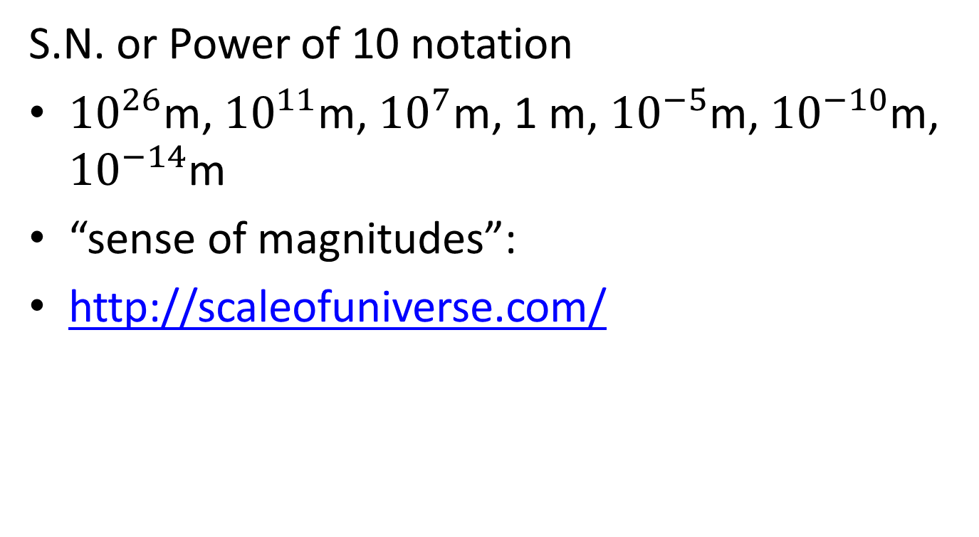
Scientific Notation and Magnitudes
S.N. or Power of 10 notation
${10}^{26}$m, ${10}^{11}$m, ${10}^{7}$m, 1 m, ${10}^{−5}$m, ${10}^{−10}$m, ${10}^{−14}$m
“sense of magnitudes”:
http://scaleofuniverse.com/

Slide 23
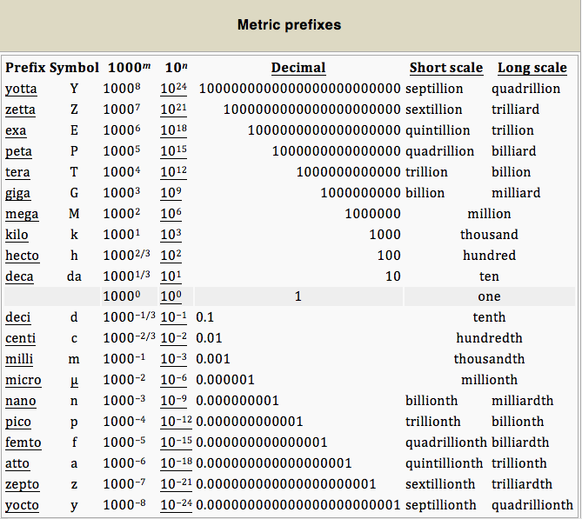

Slide 24
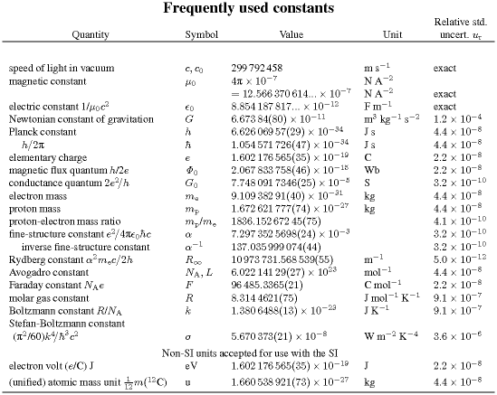
Scientific Constants

Slide 25

Converting Units
Factor-label or “railroad” method
A limitation of the factor-label method is that it can only convert between units that have a constant ratio that can be multiplied, or a multiplication factor. This method cannot be used between units that have a displacement, or difference factor. An example is the conversion between degrees Celsius and kelvins, or between Celsius and Fahrenheit. For these, it is best to use the specific conversion formulas:
[°F] = [°C] × ⁹⁄₅ + 32 , [ K ] = [°C] + 273.15

Slide 26
Dimensional Analysis
Right- and left- side of any equation you examine, as a rule of thumb, should have the same “dimensions”. i.e. should posses exactly the same combination of units in the same degrees.
It’s always recommended, while solving problems, to check, if dimension on both sides match. It’s a good indicator, if your calculations are correct or not.

Slide 27
Speed of Light
Since Galileo discovered Jupiter, next was Ole Roemer, who noticed Ion's(Jupiter's satellite) seasonal delays and measured speed of light.
https://www.youtube.com/watch?v=DMKE5YGLnmc
Measuring speed of light at home: https://www.youtube.com/watch?v=kpB1wezpJeE

Slide 28
Measurement of Time
An operational definition of time is highly useful in the conduct of both advanced experiments and everyday affairs of life.
Movement of sun across the sky (or Earth’s rotation around its axis)
Period of Earth’s orbit
Phases of the Moon
Pendulum
All above are highly dynamic in nature, and can’t be used for accurate measurements.

Slide 29
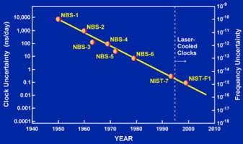
Atomic Clock
Cesium atom's, Ce55, energy difference between two lowest states and definition of second: 9,192,631,770 cycles=1 second
https://www.youtube.com/watch?v=p2BxAu6WZI8

Slide 30
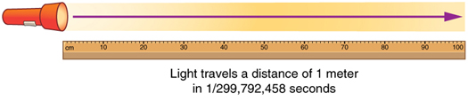
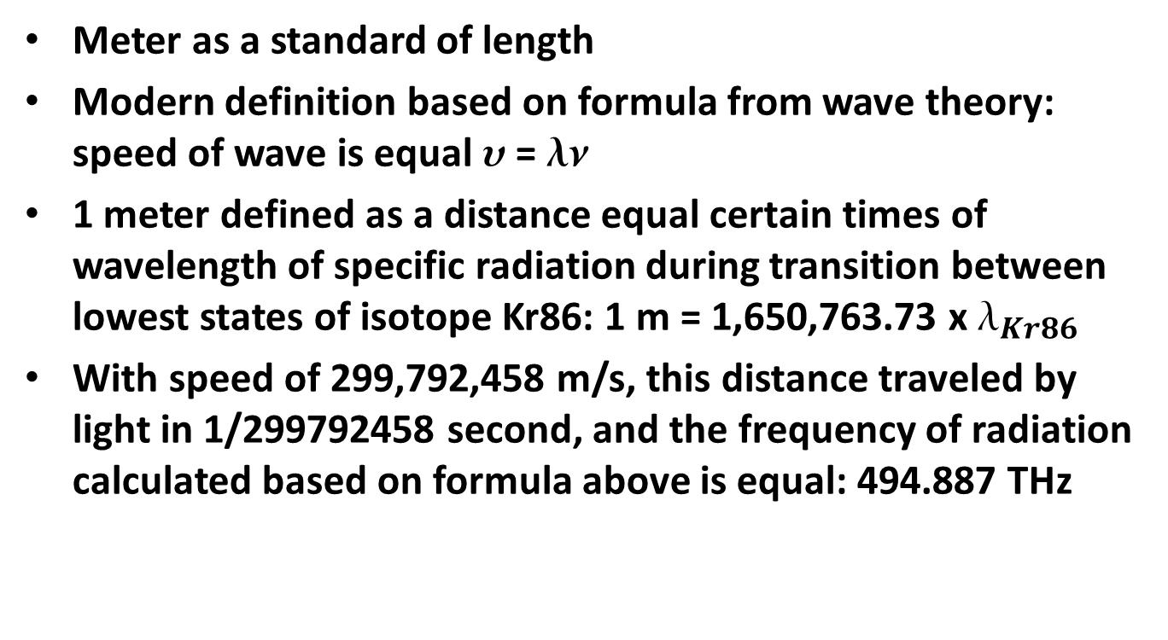
Length
Meter as a standard of length
Modern definition based on formula from wave theory: speed of wave is equal  = 
1 meter defined as a distance equal certain times of wavelength of specific radiation during transition between lowest states of isotope Kr86: 1 m = 1,650,763.73 x $_{Kr86}$
With speed of 299,792,458 m/s, this distance traveled by light in 1/299792458 second, and the frequency of radiation calculated based on formula above is equal: 494.887 THz

Slide 31
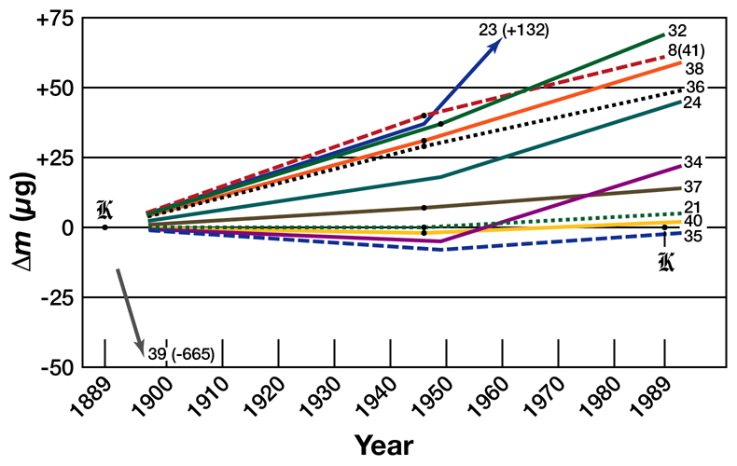
Mass
World’s Roundest Object:
https://www.youtube.com/watch?v=ZMByI4s-D-Y&index=1&list=PLebcwHGFTjCoFYmbrjBzpiC_hm0PSZO9j

Slide 32

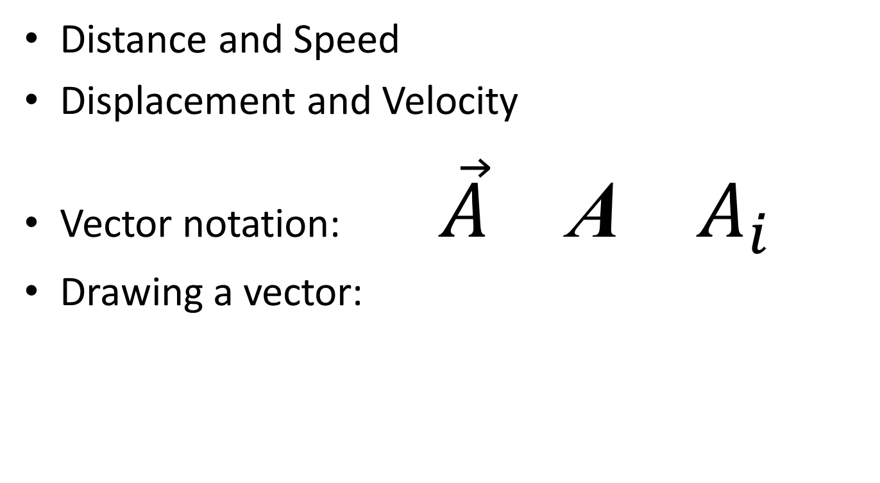

Scalars and Vectors
Distance and Speed
Displacement and Velocity
Vector notation: $\vec{A}$ A $A_{i}$
Drawing a vector:
$$P_{2}$$
$$P_{1}$$

Slide 33
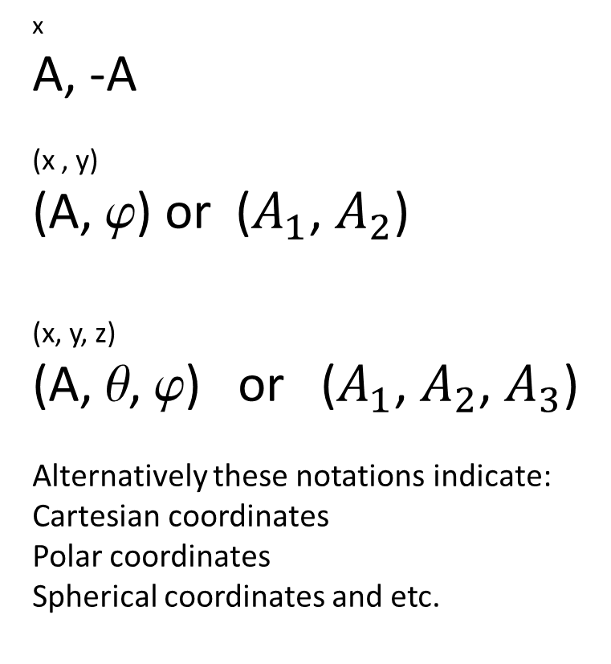
Reference Frames
1 D
0
2 D
0
3 D
0
x
A, -A
(x , y)
(A, ) or ($A_{1}$, $A_{2}$)
(x, y, z)
(A, , ) or ($A_{1}$, $A_{2}$, $A_{3}$)
Alternatively these notations indicate: Cartesian coordinates
Polar coordinates
Spherical coordinates and etc.
components

❑


Slide 34
Vector Addition
Head to tail adding
Reverse order – same result
Parallelogram adding
Parallel and antiparallel vectors
Negative vector and vector substraction
Adding by components

Slide 35
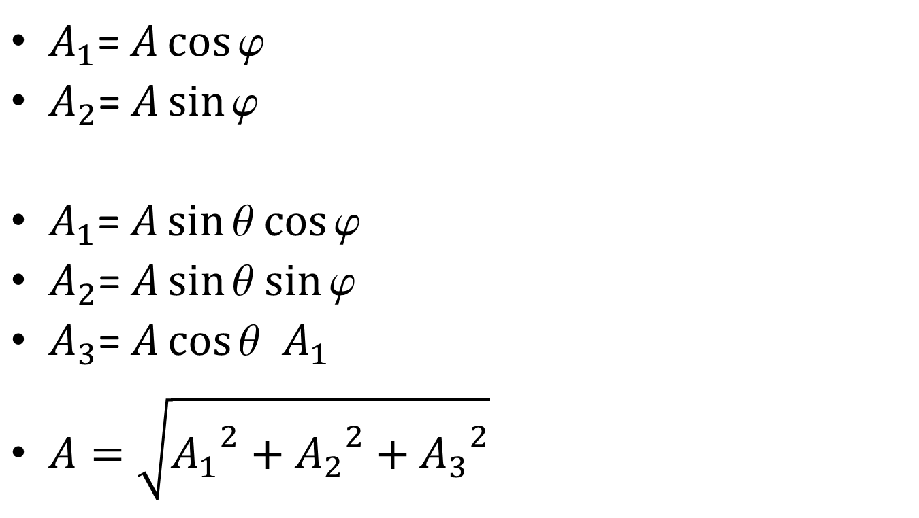
Components
$A_{1}$= $A\cos{\text{ϕ}}$
$A_{2}$= $A\sin{\text{ϕ}}$
$A_{1}$= $A\sin{\text{θ}}$ $\cos{\text{ϕ}}$
$A_{2}$= $A\sin{\text{θ}}$ $\sin{\text{ϕ}}$
$A_{3}$= $A\cos{\text{θ}}$ $A_{1}$
$A=\sqrt{{A_{1}}^{2}+{A_{2}}^{2}+{A_{3}}^{2}}$

Slide 36
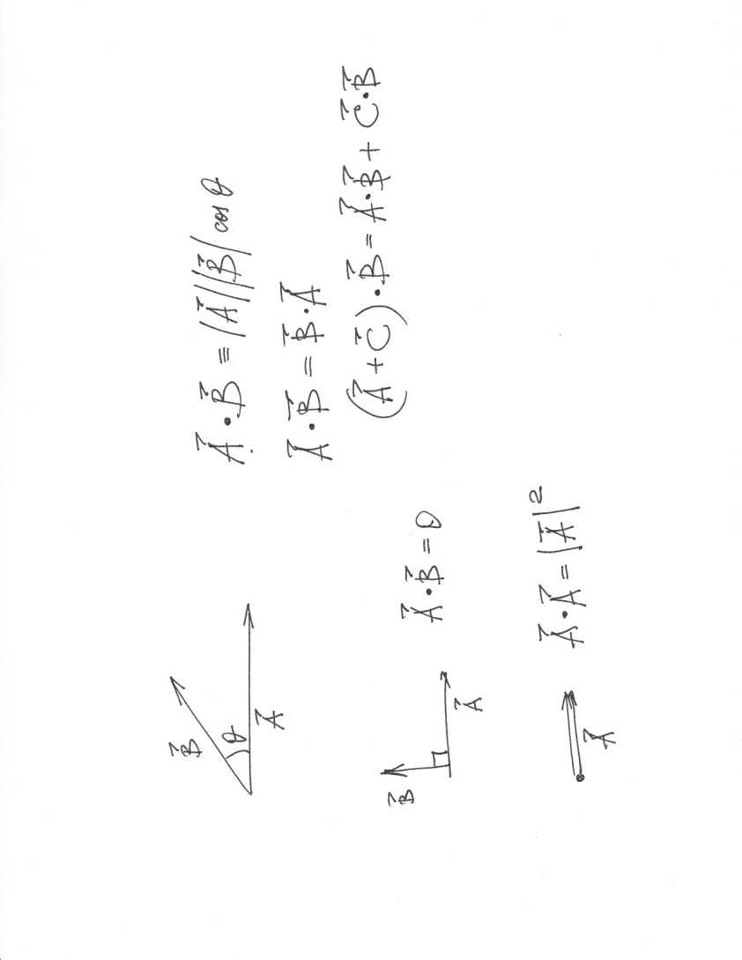
Scalar product

Slide 37
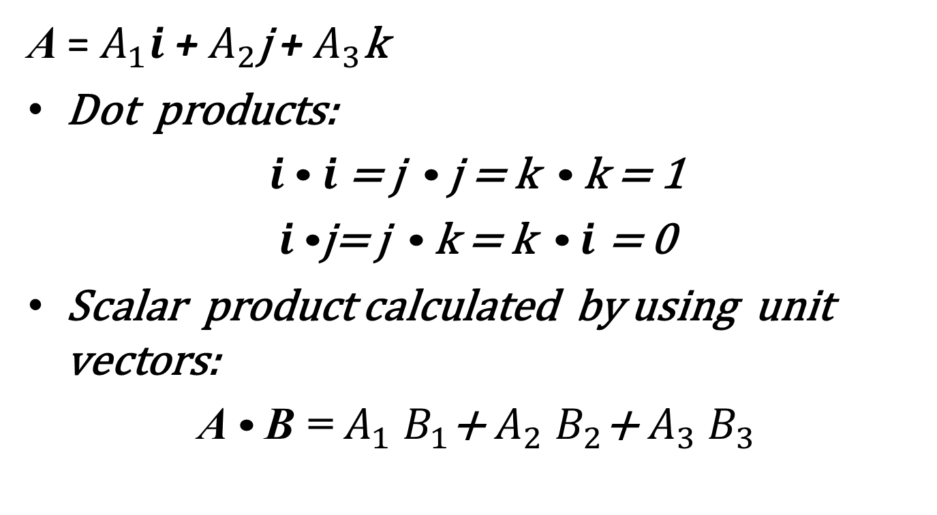
Unit vectors
A = $A_{1}i$ + $A_{2}$j + $A_{3}$k
Dot products:
$i$•$i$ = j • j = k • k = 1
$i$•j= j • k = k • $i$ = 0
Scalar product calculated by using unit vectors:
A • B = $A_{1}$ $B_{1}$+ $A_{2}$ $B_{2}$+ $A_{3}$ $B_{3}$

Slide 38
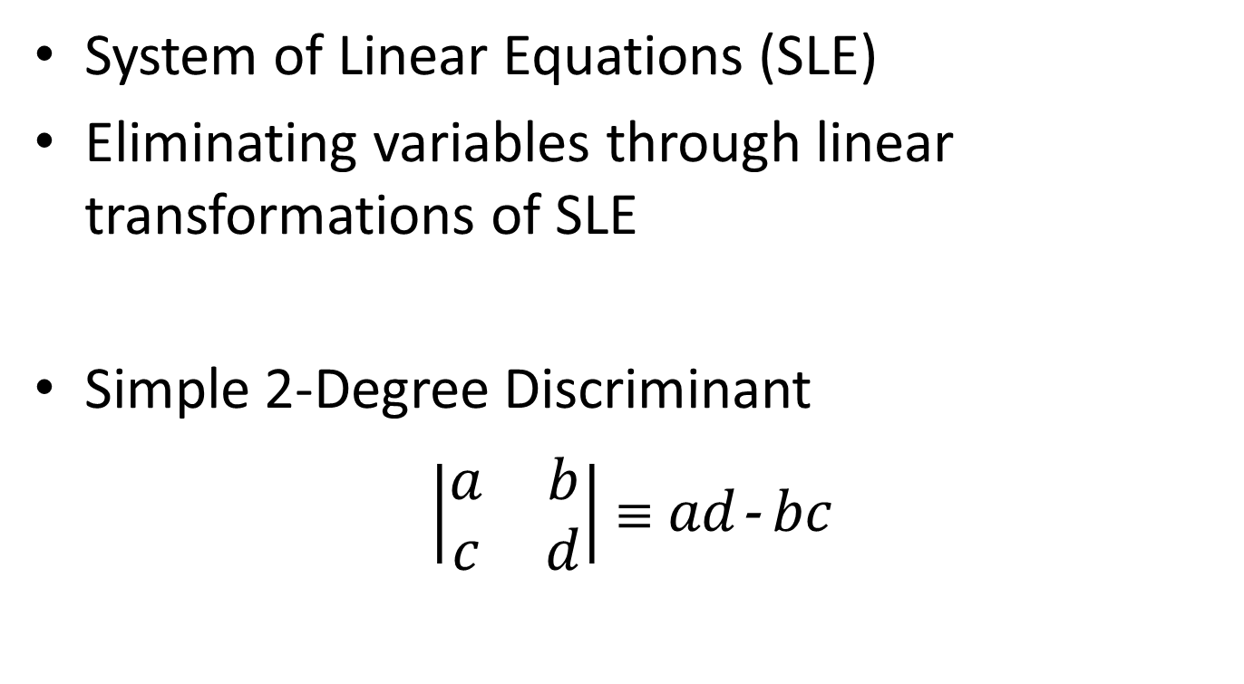
Simultaneous Linear Equations
System of Linear Equations (SLE)
Eliminating variables through linear transformations of SLE
Simple 2-Degree Discriminant
$\left|\begin{matrix}a & b \\ c & d\end{matrix}\right|$  $ad$- $bc$

Slide 39
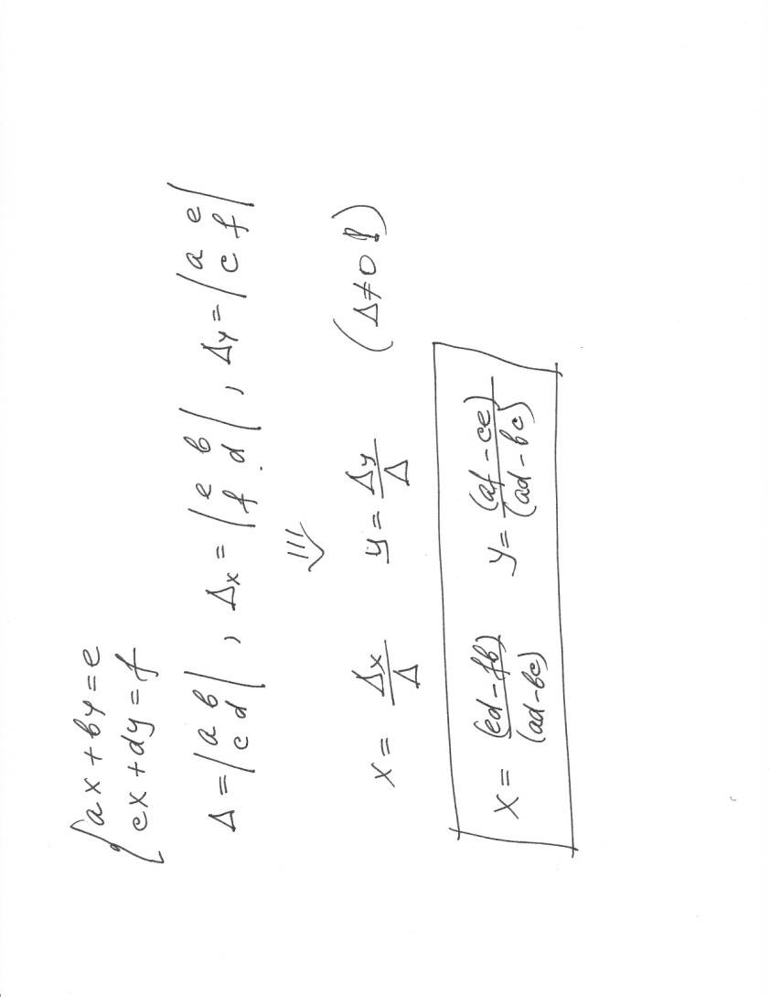
Cramer’s Method

Slide 40
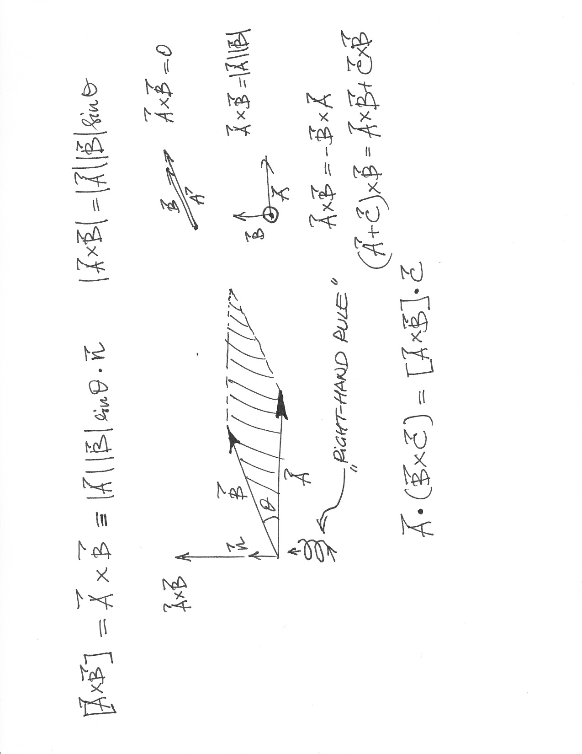
Vector Product
Also called “cross” or “x” product

Slide 41
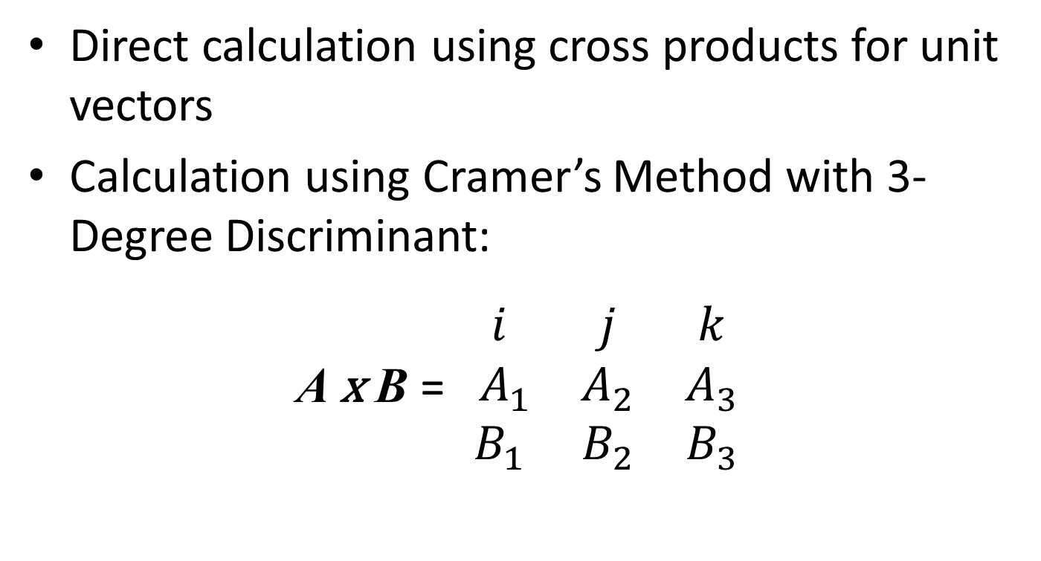
Calculating Vector Product
Direct calculation using cross products for unit vectors
Calculation using Cramer’s Method with 3-Degree Discriminant:
A x B = $\begin{matrix}i & j & k \\ { A}_{1} & A_{2} & A_{3} \\ B_{1} & B_{2} & B_{3}\end{matrix}$

Slide 42
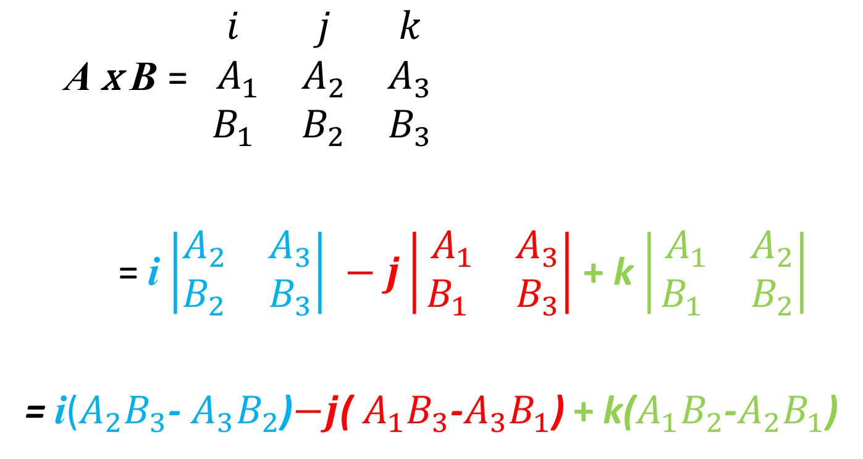
Calculation (cont.)
A x B = $\begin{matrix}i & j & k \\ { A}_{1} & A_{2} & A_{3} \\ B_{1} & B_{2} & B_{3}\end{matrix}$
= i $\left|\begin{matrix}A_{2} & A_{3} \\ B_{2} & B_{3}\end{matrix}\right| −j\left|\begin{matrix}{ A}_{1} & A_{3} \\ B_{1} & B_{3}\end{matrix}\right|$ + k $\left|\begin{matrix}{ A}_{1} & A_{2} \\ B_{1} & B_{2}\end{matrix}\right|$
= i($A_{2}B_{3}$- $A_{3}B_{2}$)$−j$(${ A}_{1}B_{3}$-$A_{3}B_{1}$) + k($A_{1}B_{2}$-$A_{2}B_{1}$)

Slide 43
Ch.1
End
PHYS 2325

Slide 44
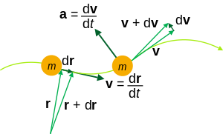


Basics of Kinematics
Kinematics > Basics of Kinematics
Introduction
Reference Frames and Displacement
Introduction to Scalars and Vectors
Free to share, print, make copies and changes. Get yours at www.boundless.com
www.boundless.com/physics

Slide 45
Introduction
Kinematics > Basics of Kinematics
To describe motion, kinematics studies the trajectories of points, lines and other geometric objects.
The study of kinematics can be abstracted into purely mathematical expressions.
Kinematic equations can be used to calculate various aspects of motion such as velocity, acceleration, displacement, and time.
Kinematics of a particle trajectory
View on Boundless.com
Free to share, print, make copies and changes. Get yours at www.boundless.com
www.boundless.com/physics/textbooks/boundless-physics-textbook/kinematics-2/basics-of-kinematics-35/introduction-207-6213

Slide 46
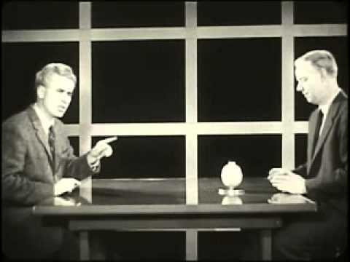
Reference Frames and Displacement
Kinematics > Basics of Kinematics
Choosing a frame of reference requires deciding where the object's initial position is and which direction will be considered positive.
Valid frames of reference can differ from each other by moving relative to one another.
Frames of reference are particularly important when describing an object's displacement.
Displacement is the change in position of an object relative to its reference frame.
Frames of Reference (1960) Educational Film
View on Boundless.com
Free to share, print, make copies and changes. Get yours at www.boundless.com
www.boundless.com/physics/textbooks/boundless-physics-textbook/kinematics-2/basics-of-kinematics-35/reference-frames-and-displacement-208-6691

Slide 47

Introduction to Scalars and Vectors
Kinematics > Basics of Kinematics
A vector is any quantity that has magnitude and direction.
A scalar is any quantity that has magnitude but no direction.
Displacement and velocity are vectors, whereas distance and speed are scalars.
Scalars and Vectors
View on Boundless.com
Free to share, print, make copies and changes. Get yours at www.boundless.com
www.boundless.com/physics/textbooks/boundless-physics-textbook/kinematics-2/basics-of-kinematics-35/introduction-to-scalars-and-vectors-209-6214

Slide 48
Appendix
Free to share, print, make copies and changes. Get yours at www.boundless.com

Slide 49
Key terms
Kinematics
displacement A vector quantity that denotes distance with a directional component.
frame of reference A coordinate system or set of axes within which to measure the position, orientation, and other properties of objects in it.
kinematics The branch of mechanics concerned with objects in motion, but not with the forces involved.
scalar A quantity that has magnitude but not direction; compare vector.
vector A directed quantity, one with both magnitude and direction; the between two points.
Free to share, print, make copies and changes. Get yours at www.boundless.com

Slide 50
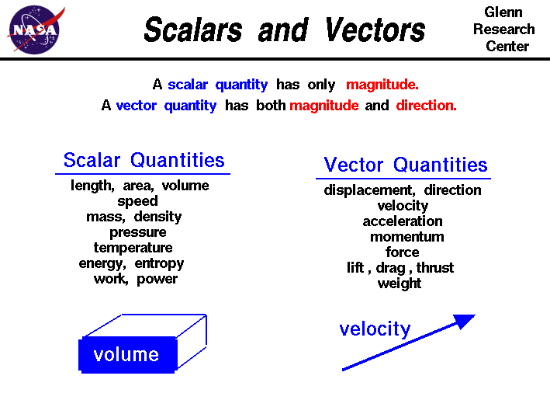
Kinematics
Scalars vs. Vectors
  A brief list of quantities that are either scalars or vectors.
Free to share, print, make copies and changes. Get yours at www.boundless.com
National Air and Space Association. "Scalars and Vectors." Public domain http://www.grc.nasa.gov/WWW/k-12/airplane/vectors.html View on Boundless.com

Slide 51
Kinematics
Frames of Reference (1960) Educational Film
  Frames of Reference is a 1960 educational film by Physical Sciences Study Committee.The film was made to be shown in high school physics courses.In the film University of Toronto physics professors Patterson Hume and Donald Ivey explain the distinction between inertial and nonintertial frames of reference, while demonstrating these concepts through humorous camera tricks.For example, the film opens with Dr.Hume, who appears to be upside down, accusing Dr.Ivey of being upside down.Only when the pair flip a coin does it become obvious that Dr.Ivey — and the camera — are indeed inverted.The film's humor serves both to hold students' interest and to demonstrate the concepts being discussed.This PSSC film utilizes a fascinating set consisting of a rotating table and furniture occupying surprisingly unpredictable spots within the viewing area.The fine cinematography by Abraham Morochnik, and funny narration by University of Toronto professors Donald Ivey and Patterson Hume is a wonderful example of the fun a creative team of filmmakers can have with a subject that other, less imaginative types might find pedestrian.Producer: Richard Leacock Production Company: Educational Development Corp.Sponsor: Eric Prestamon
Free to share, print, make copies and changes. Get yours at www.boundless.com
YouTube. "Frames of Reference (1960) Educational Film." Youtube License http://www.youtube.com/watch?v=aRDOqiqBUQY View on Boundless.com

Slide 52
Kinematics
Vector representation
  A vector is frequently represented by a line segment with a definite direction, or graphically as an arrow, connecting an initial point A with a terminal point B.
Free to share, print, make copies and changes. Get yours at www.boundless.com
Wikipedia. "Vector (physics)." CC BY http://en.wikipedia.org/wiki/Vector_(physics) View on Boundless.com

Slide 53
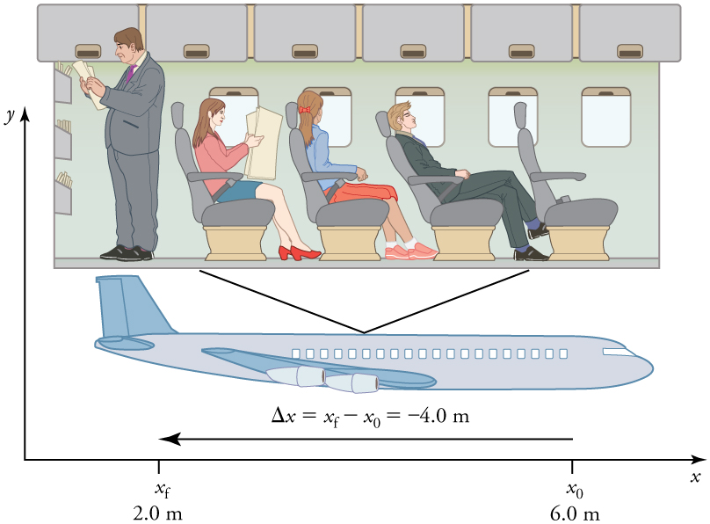
Kinematics
Displacement in Terms of Frame of Reference
  A passenger moves from his seat to the back of the plane.His location relative to the airplane is given by x.The -4.0m displacement of the passenger relative to the plane is represented by an arrow toward the rear of the plane.Notice that the arrow representing his displacement is twice as long as the arrow representing the displacement of the professor (he moves twice as far).
Free to share, print, make copies and changes. Get yours at www.boundless.com
Connexions. "Displacement." CC BY 3.0 http://cnx.org/content/m42033/latest/?collection=col11406/1.7 View on Boundless.com

Slide 54
Kinematics
Kinematics of a particle trajectory
  Kinematic equations can be used to calculate the trajectory of particles or objects.The quantities of a classical particle include: mass m, position r, velocity v, acceleration a.
Free to share, print, make copies and changes. Get yours at www.boundless.com
Wikipedia. "Kinematics." CC BY http://en.wikipedia.org/wiki/Kinematics View on Boundless.com

Slide 55
Kinematics
Scalars and Vectors
  Mr. Andersen explains the differences between scalar and vectors quantities. He also uses a demonstration to show the importance of vectors and vector addition.
Free to share, print, make copies and changes. Get yours at www.boundless.com
YouTube. "Scalars and Vectors - YouTube." Youtube License https://www.youtube.com/watch?t=1m9s&v=EUrMI0DIh40 View on Boundless.com

Slide 56
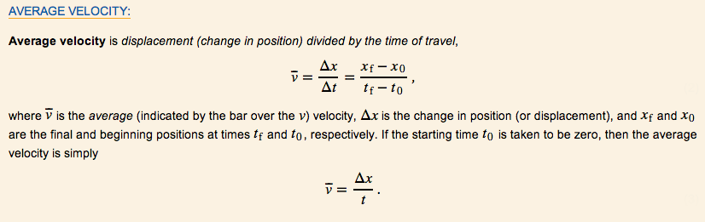
Speed and Velocity
Kinematics > Speed and Velocity
Average Velocity: A Graphical Interpretation
Instananeous Velocity: A Graphical Interpretation
Free to share, print, make copies and changes. Get yours at www.boundless.com
www.boundless.com/physics

Slide 57
Average Velocity: A Graphical Interpretation
Kinematics > Speed and Velocity
Average velocity can be calculated by determining the total displacement divided by the total time of travel.
The average velocity of an object does not tell us anything about what happens to it between the starting point and ending point.
Average velocity is different from average speed in that it considers the direction of travel and the overall change in position.
Average Velocity
View on Boundless.com
Free to share, print, make copies and changes. Get yours at www.boundless.com
www.boundless.com/physics/textbooks/boundless-physics-textbook/kinematics-2/speed-and-velocity-36/average-velocity-a-graphical-interpretation-210-6244

Slide 58
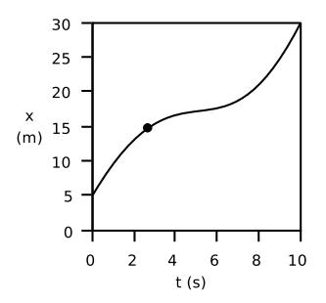
Instananeous Velocity: A Graphical Interpretation
Kinematics > Speed and Velocity
When velocity is constantly changing, we can estimate our velocity by looking at instantaneous velocity.
Instantaneous velocity is calculated by determining the slope of the line tangent to the curve at the point of interest.
Instantaneous velocity is similar to determining how many meters the object would travel in one second at a specific moment.
Motion with Changing Velocity
View on Boundless.com
Free to share, print, make copies and changes. Get yours at www.boundless.com
www.boundless.com/physics/textbooks/boundless-physics-textbook/kinematics-2/speed-and-velocity-36/instananeous-velocity-a-graphical-interpretation-211-6362

Slide 59
Appendix
Free to share, print, make copies and changes. Get yours at www.boundless.com

Slide 60
Key terms
Kinematics
instantaneous (As in velocity)—occurring, arising, or functioning without any delay; happening within an imperceptibly brief period of time.
velocity A vector quantity that denotes the rate of change of position with respect to time, or a speed with a directional component.
Free to share, print, make copies and changes. Get yours at www.boundless.com

Slide 61
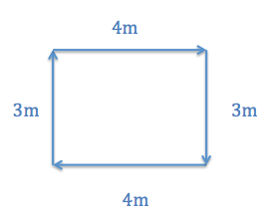
Kinematics
Average Speed vs. Average Velocity
  If you started walking from one corner and went all the way around the rectangle in 30 seconds, your average speed would be 0.47 m/s, but your average velocity would be 0 m/s.
Free to share, print, make copies and changes. Get yours at www.boundless.com
http://None. CC BY-SA 3.0 http://None View on Boundless.com

Slide 62
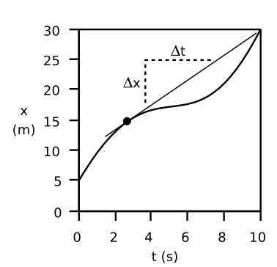
Kinematics
Determining instantaneous velocity
  The velocity at any given moment is deﬁned as the slope of the tangent line through the relevant point on the graph
Free to share, print, make copies and changes. Get yours at www.boundless.com
Light and Matter. CC BY http://lightandmatter.com/lmb.pdf View on Boundless.com

Slide 63
Kinematics
Average Velocity
  The kinematic formula for calculating average velocity is the change in position over the time of travel.
Free to share, print, make copies and changes. Get yours at www.boundless.com
Connexions. "Time, Velocity, and Speed." CC BY 3.0 http://cnx.org/content/m42096/latest/?collection=col11406/1.7 View on Boundless.com

Slide 64
Kinematics
Motion with Changing Velocity
  Motion is often observed with changing velocity.This would result in a curvy line when graphed with distance over time.
Free to share, print, make copies and changes. Get yours at www.boundless.com
Light and Matter. CC BY http://lightandmatter.com/lmb.pdf View on Boundless.com

Slide 65
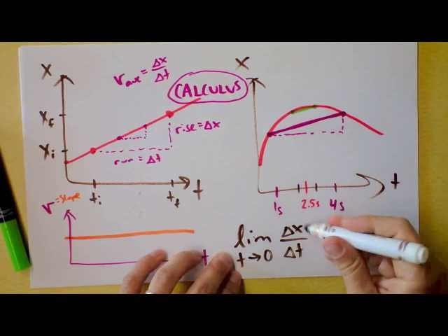
Kinematics
Instantaneous Velocity, Acceleration, Jerk, Slopes, Graphs vs. Time
  This is how kinematics begins.
Free to share, print, make copies and changes. Get yours at www.boundless.com
YouTube. "Doc Physics - Instantaneous Velocity, Acceleration, Jerk, Slopes, Graphs vs. Time - YouTube." Youtube License https://www.youtube.com/watch?t=1m57s&v=STcgrV2L4tw View on Boundless.com

Slide 66
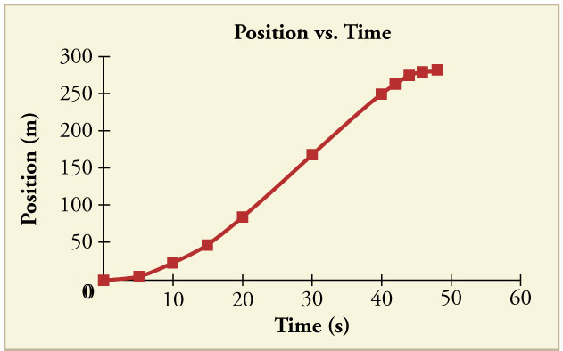
Acceleration
Kinematics > Acceleration
Graphical Interpretation
Motion with Constant Acceleration
Free to share, print, make copies and changes. Get yours at www.boundless.com
www.boundless.com/physics

Slide 67
Graphical Interpretation
Kinematics > Acceleration
Acceleration is the rate at which the velocity of a body changes with time.
Acceleration is a vector that points in the same direction as the change in velocity, though it may not always be in the direction of motion.
Because acceleration is velocity in m/s divided by time in s, we can derive a graph of acceleration from a graph of an object's speed or position.
Position vs Time Graph
View on Boundless.com
Free to share, print, make copies and changes. Get yours at www.boundless.com
www.boundless.com/physics/textbooks/boundless-physics-textbook/kinematics-2/acceleration-37/graphical-interpretation-212-6234

Slide 68
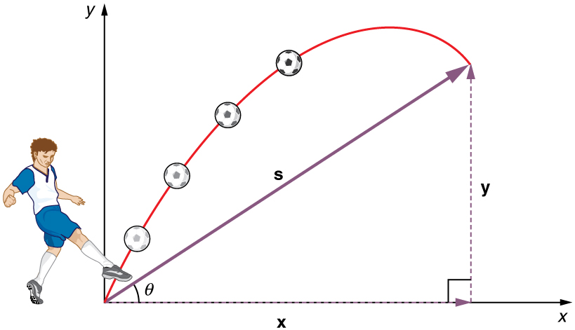
Motion with Constant Acceleration
Kinematics > Acceleration
Assuming acceleration to be constant does not seriously limit the situations we can study and does not degrade the accuracy of our treatment.
Due to the algebraic properties of constant acceleration, there are kinematic equations that can be used to calculate displacement, velocity, acceleration, and time.
Calculations with constant acceleration can be done in relation to one-dimensional motion as well as two-dimensional motion.
Projectile Motion with Constant Acceleration
View on Boundless.com
Free to share, print, make copies and changes. Get yours at www.boundless.com
www.boundless.com/physics/textbooks/boundless-physics-textbook/kinematics-2/acceleration-37/motion-with-constant-acceleration-213-149

Slide 69
Appendix
Free to share, print, make copies and changes. Get yours at www.boundless.com

Slide 70
Key terms
Kinematics
acceleration The amount by which a speed or velocity increases (and so a scalar quantity or a vector quantity).
acceleration The amount by which a speed or velocity increases (and so a scalar quantity or a vector quantity).
kinematic of or relating to motion or kinematics
position A place or location.
velocity A vector quantity that denotes the rate of change of position with respect to time, or a speed with a directional component.
Free to share, print, make copies and changes. Get yours at www.boundless.com

Slide 71
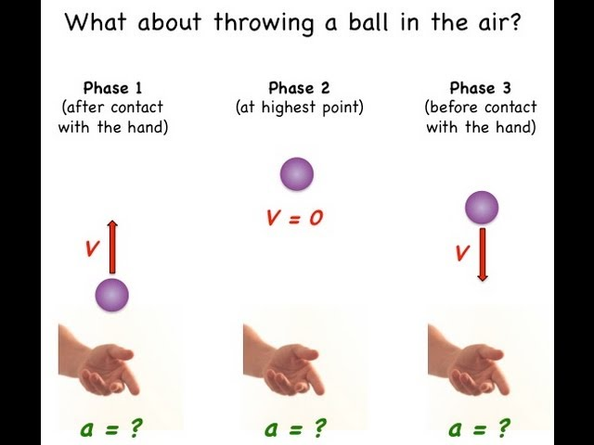
Kinematics
Constant Acceleration Explained with Vectors and Algebra
  This video answers the question "what is acceleration?".
Free to share, print, make copies and changes. Get yours at www.boundless.com
YouTube. "Constant Acceleration Explained with Vectors and Algebra - YouTube." Youtube License https://www.youtube.com/watch?t=4m0s&v=-4pV1HibhlU View on Boundless.com

Slide 72
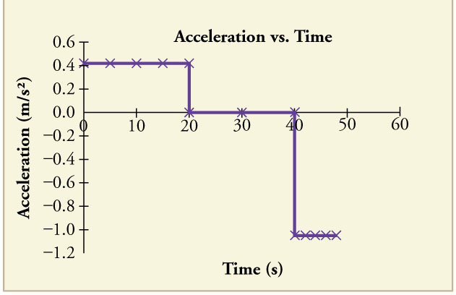
Kinematics
Acceleration vs Time Graph
  The object has positive acceleration as it speeds up at the beginning of the journey.It has no acceleration as it travels at constant velocity in the middle of the journey.Its acceleration is negative as it slows down at the end of the journey.
Free to share, print, make copies and changes. Get yours at www.boundless.com
Connexions. "Acceleration." CC BY 3.0 http://cnx.org/content/m42100/latest/?collection=col11406/1.7 View on Boundless.com

Slide 73
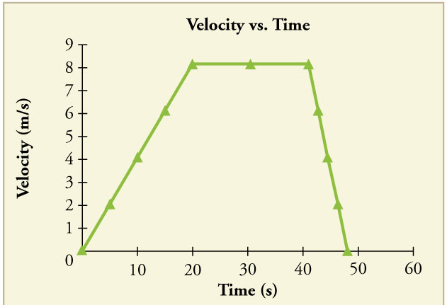
Kinematics
Velocity vs Time
  The object's velocity increases as it accelerates at the beginning of the journey.It remains the same in the middle of the journey (where there is no acceleration).It decreases as the object decelerates at the end of the journey.
Free to share, print, make copies and changes. Get yours at www.boundless.com
Connexions. "Acceleration." CC BY 3.0 http://cnx.org/content/m42100/latest/?collection=col11406/1.7 View on Boundless.com

Slide 74
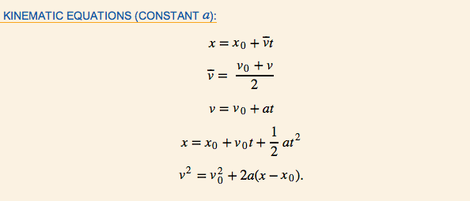
Kinematics
Kinematic Equations
  A summary of kinematic equations that can be used in scenarios with a constant acceleration
Free to share, print, make copies and changes. Get yours at www.boundless.com
Connexions. "Motion Equations for Constant Acceleration in One Dimension." CC BY 3.0 http://cnx.org/content/m42099/latest/?collection=col11406/1.7 View on Boundless.com

Slide 75
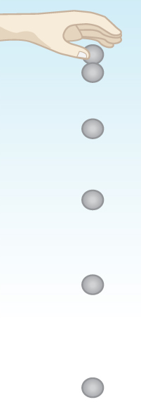
Kinematics
One-Dimensional Motion
  When you drop an object, it falls vertically toward the center of the earth due to the constant acceleration of gravity.
Free to share, print, make copies and changes. Get yours at www.boundless.com
Connexions. "Falling Objects." CC BY 3.0 http://cnx.org/content/m42102/latest/?collection=col11406/1.7 View on Boundless.com

Slide 76
Kinematics
Position vs Time Graph
  Notice that the object's position changes slowly at the beginning of the journey, then more and more quickly as it picks up speed.Its position then changes more slowly as it slows down at the end of the journey.In the middle of the journey, while the velocity remains constant, the position changes at a constant rate.
Free to share, print, make copies and changes. Get yours at www.boundless.com
Connexions. "Acceleration." CC BY 3.0 http://cnx.org/content/m42100/latest/?collection=col11406/1.7 View on Boundless.com

Slide 77
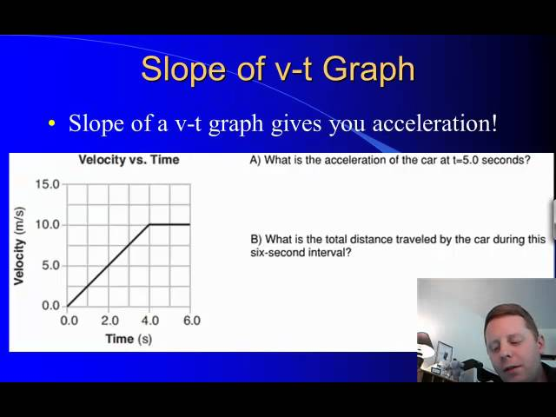
Kinematics
Graphing Motion
  A brief introduction to particle diagrams and motion graphs.
Free to share, print, make copies and changes. Get yours at www.boundless.com
YouTube. "High School Physics: Graphing Motion - YouTube." Youtube License https://www.youtube.com/watch?t=0m6s&v=vYXf7Q9j9qA View on Boundless.com

Slide 78
Kinematics
Which of the following is correct about a plotted graph of velocity or a plotted graph of acceleration?
A) Acceleration is distance over time
B) Velocity is acceleration over time
C) Acceleration is velocity over time
D) Velocity is time over distance
Free to share, print, make copies and changes. Get yours at www.boundless.com

Slide 79
Kinematics
Which of the following is correct about a plotted graph of velocity or a plotted graph of acceleration?
A) Acceleration is distance over time
B) Velocity is acceleration over time
C) Acceleration is velocity over time
D) Velocity is time over distance
Free to share, print, make copies and changes. Get yours at www.boundless.com
Boundless - LO. "Boundless." CC BY-SA 3.0 http://www.boundless.com/

Slide 80
Kinematics
In the graph on acceleration, how does the acceleration act in the three different stages of motion?
A) Acceleration is a negative constant, then a constant of zero, then a positive constant
B) Acceleration is a positive constant throughout all three stages
C) Acceleration is a positive constant, then a constant of zero, then a negative constant
D) Acceleration is a constant zero throughout all three stages
Free to share, print, make copies and changes. Get yours at www.boundless.com

Slide 81
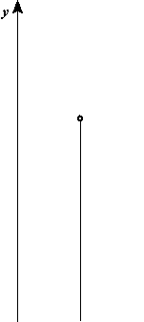
Free-Falling Objects
Kinematics > Free-Falling Objects
Free-Falling Objects
Free to share, print, make copies and changes. Get yours at www.boundless.com
www.boundless.com/physics

Slide 82
Free-Falling Objects
Kinematics > Free-Falling Objects
The acceleration of free-falling objects is called the acceleration due to gravity, since objects are pulled towards the center of the earth.
The acceleration due to gravity is constant on the surface of the Earth and has the value of 9.80 m/s².
Free Fall
View on Boundless.com
Free to share, print, make copies and changes. Get yours at www.boundless.com
www.boundless.com/physics/textbooks/boundless-physics-textbook/kinematics-2/free-falling-objects-39/free-falling-objects-216-10955

Slide 83
Appendix
Free to share, print, make copies and changes. Get yours at www.boundless.com

Slide 84
Key terms
Kinematics
acceleration The amount by which a speed or velocity changes within a certain period of time (and so a scalar quantity or a vector quantity).
Free to share, print, make copies and changes. Get yours at www.boundless.com

Slide 85
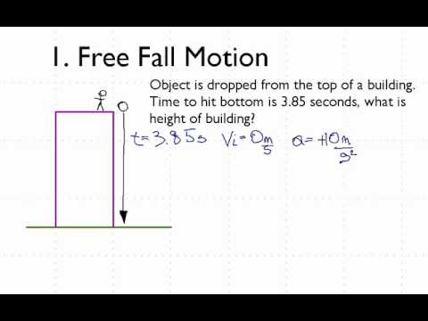
Kinematics
Free Fall Motion - YouTube
  Describes how to calculate the time for an object to fall if given the height and the height that an object fell if given the time to fall.
Free to share, print, make copies and changes. Get yours at www.boundless.com
YouTube. "Free Fall Motion - YouTube." Youtube License https://www.youtube.com/watch?t=0m2s&v=C6-AxMc9mig View on Boundless.com

Slide 86
Kinematics
Free Fall
  This clip shows an object in free fall.
Free to share, print, make copies and changes. Get yours at www.boundless.com
Wikipedia. "Free-fall." CC BY-SA http://en.wikipedia.org/wiki/File:Free-fall.gif View on Boundless.com

Slide 87

Problem-Solving for Basic Kinematics
Kinematics > Problem-Solving for Basic Kinematics
Applications
Motion Diagrams
Free to share, print, make copies and changes. Get yours at www.boundless.com
www.boundless.com/physics

Slide 88

Applications
Kinematics > Problem-Solving for Basic Kinematics
The four kinematic equations involve five kinematic variables: d, v, v_{o}, a, and t.
Each equation contains only four of the five variables and has a different one missing.
It is important to choose the equation that contains the three known variables and one unknown variable for each specific situation.
View on Boundless.com
Free to share, print, make copies and changes. Get yours at www.boundless.com
www.boundless.com/physics/textbooks/boundless-physics-textbook/kinematics-2/problem-solving-for-basic-kinematics-38/applications-214-5622

Slide 89
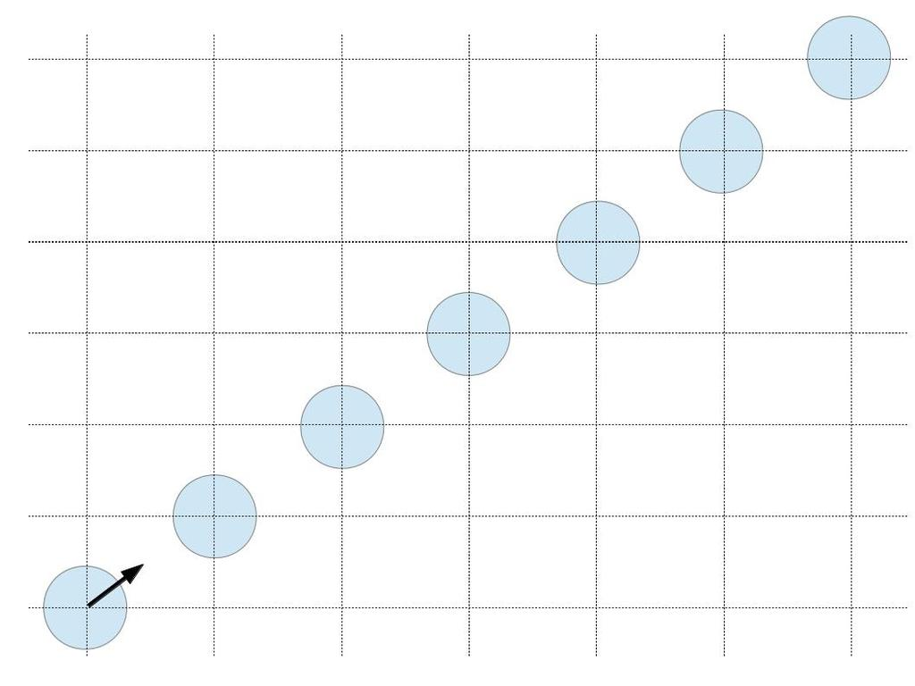
Motion Diagrams
Kinematics > Problem-Solving for Basic Kinematics
Motion diagrams represent the motion of an object by displaying its location at various equally spaced times on the same diagram.
Motion diagrams show an object's initial position and velocity and presents several spots in the center of the diagram.These spots reveal the object's state of motion.
Motion diagrams contain information about an object's position at particular time instances and is therefore more informative than a path diagram.
Puck Sliding on Ice
View on Boundless.com
Free to share, print, make copies and changes. Get yours at www.boundless.com
www.boundless.com/physics/textbooks/boundless-physics-textbook/kinematics-2/problem-solving-for-basic-kinematics-38/motion-diagrams-215-294

Slide 90
Appendix
Free to share, print, make copies and changes. Get yours at www.boundless.com

Slide 91
Key terms
Kinematics
diagram A graph or chart.
kinematics The branch of physics concerned with objects in motion.
motion A change of position with respect to time.
stroboscopic Relating to an instrument used to make a cyclically moving object appear to be slow-moving, or stationary.
Free to share, print, make copies and changes. Get yours at www.boundless.com

Slide 92
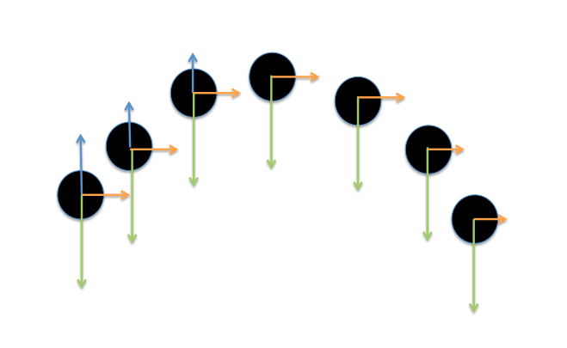
Kinematics
Motion diagram of trajectory
  The green arrow represents the downward acceleration of gravity, the blue and orange arrows represent the directional velocity.
Free to share, print, make copies and changes. Get yours at www.boundless.com
http://drawn. CC BY-SA 3.0 http://drawn View on Boundless.com

Slide 93
Kinematics
Puck Sliding on Ice
  Motion diagram of a puck sliding on ice.The puck is moving at a constant velocity.
Free to share, print, make copies and changes. Get yours at www.boundless.com
Amazon Web Services. "Boundless." CC BY http://s3.amazonaws.com/figures.boundless.com/51129b2ee4b0c14bf464ce1b/1.jpg View on Boundless.com

Slide 94
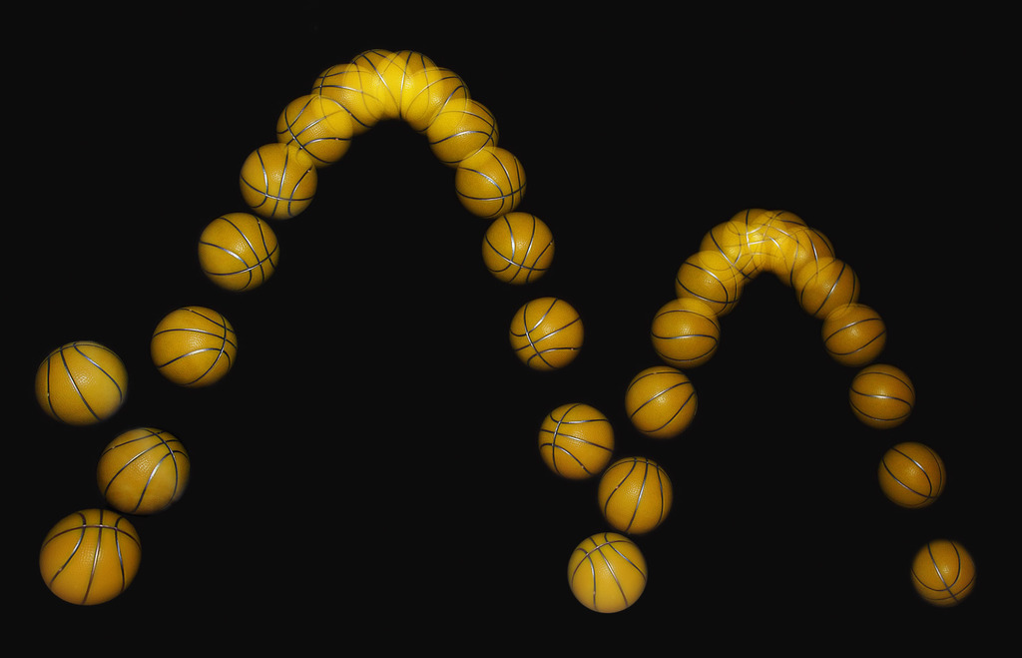
Kinematics
Bouncing Ball
  A bouncing ball captured with a stroboscopic flash at 25 images per second.
Free to share, print, make copies and changes. Get yours at www.boundless.com
Wikimedia. CC BY http://upload.wikimedia.org/wikipedia/commons/3/3c/Bouncing_ball_strobe_edit.jpg View on Boundless.com

